Slide 1


K-means and the Telco Churn Case (part 2)
Wake Forest
School of Business
_______
BAN 6025

Slide 2
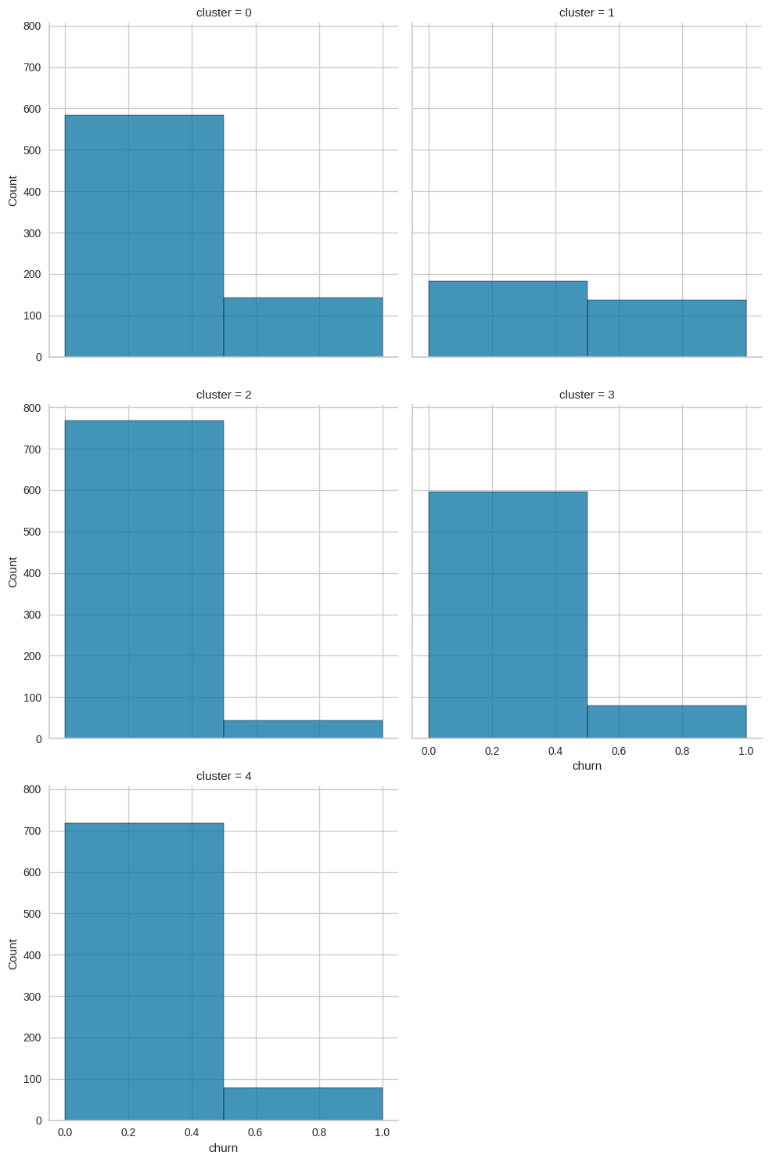
Cluster Profiling: Customer Churn within Clusters

Slide 3

Cluster 0: Daytime Danny
Very high day time charges
Minimal add-ons
Slightly elevated risk for churn

Slide 4

Cluster 1: Risky Rosie
Average charges during all time slots
Lots of add-ons (voicemail, international calling)
Huge range in international calling and voicemail messages (suggesting that these add-ons are not being fully utilized
Elevated risk for churn (almost 50% of the customers in this segment churned)

Slide 5

Cluster 2: Satisfied Shane
Average charges across all time ranges
Everyone has a voicemail plan
No one has an international plan
Least likely to churn

Slide 6

Cluster 3: Afternoon Alex
Very high evening charges
Minimal add-ons
Low risk for churn

Slide 7

Cluster 5: Nightime Nancy
Very high night charges
Very low day charges
Minimal add-ons
Low risk for churn

